Slide 1
Virtual Event Production 201
For Web-Based outreach or Web-Based Training

Slide 2
Administration for Community Living, Office of Healthcare Information and Counseling
Managing Through COVID-19 Workgroup
Adapted from training produced by the Senior Medicare Patrol (SMP) National Resource Center
September 2020

Slide 3
Platforms We Will Cover
Webex
Go To Webinar or Go To Meeting
Skype
Ready Talk and Zoom
Tips and Resources

Slide 4
Poll: Which web conferencing platform are you using? (select all that apply)
WebEx
GoToMeeting/GoToWebinar
ReadyTalk
Zoom
Google Hangouts
Skype
Other (type your answer in chat)
Notes:
Heather
Poll

Slide 5
Webex
Content Provided by the Idaho State health Insurance Assistance Program, called “SHIBA”

Slide 6
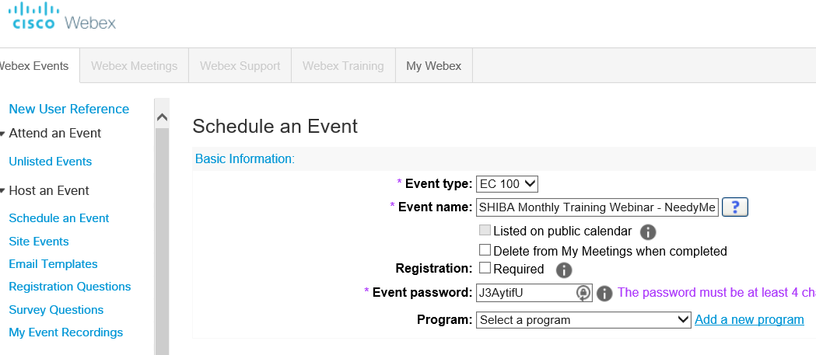
WebEx for Training Webinars

Slide 7
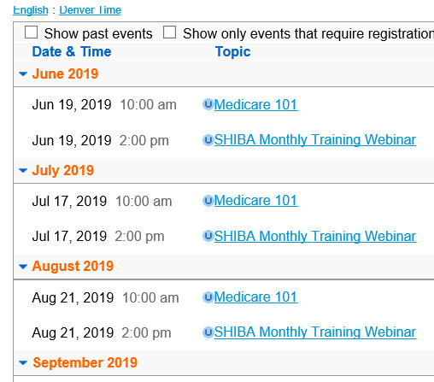
Uses and Observations
Acquired through state agency contract so no comparison to other products was possible
Used for statewide Medicare workshops and volunteer training classes, not meetings

Slide 8
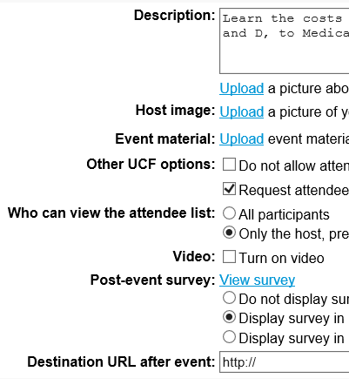
Uses and Observations
Limit of 1000 attendees (20-50 is normal)
Email lists can be uploaded from Excel files and invitations sent from the platform
Password entry keys available
Video available
Surveys available

Slide 9
Uses and Observations
Recordings easily downloadable for future use

Slide 10
Obstacles and Suggestions
Audio via web or phone, but always an issue for someone.
The scheduling interface can be difficult to understand and features are easy to miss. Suggest creating several test events prior to going live.
Test the speaker’s microphone, camera, and screen share prior to opening the event.
Chat and Question features can be difficult to manage.
Decide how questions will be taken (voice, chat, Q&A) and who will manage them. If possible, have the host do this while the presenter concentrates on the presentation.

Slide 11
GoToWebinar and GoToMeeting
Content provided by Age Options, Illinois Senior Medicare Patrol

Slide 12
Current Uses
Quarterly partner meetings
Training for state partners and volunteers
Data System Trainings
Special Grant Info session
Volunteer retention
Invitees: partners and volunteers
12
Notes:
Very easy to use

Slide 13
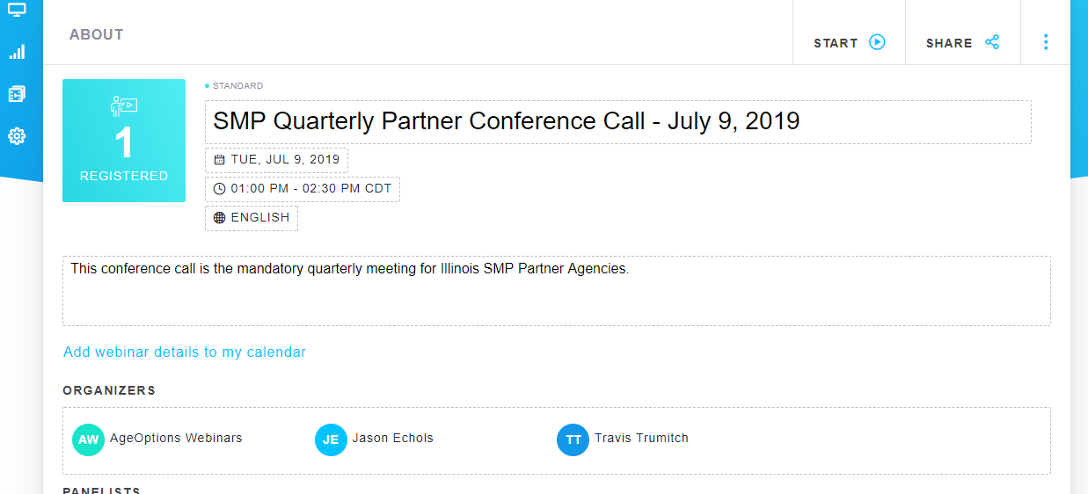
Setting up a Webinar
13
Notes:
Very easy to create. Adding organizers is super Got Webinar easy and gives access for people to work from different work stations.

Slide 14
Scheduling a Webinar
14
Notes:
You can add email addresses and it send an email to register to all your invitees with click of one button.
It automatically creates an outlook calendar event.
Sends reminder email to people who have not registered yet.

Slide 15
Sending the Invitation
15
Notes:
Outlook calendar event

Slide 16
Extra Features
16
Notes:
Provide surveys before event to get feedback and information for webinar.

Slide 17
Dashboard
17
Notes:
You have to download go to client but then it automatically opens after one download
Can call in or use computer microphone
When hit start, video is recorded

Slide 18
Best Features
Video is automatically downloaded and can be shared to attendees.
Sharing your screen allows you to have PowerPoints, PDF, websites, etc.
Creating polls during webinar.
Easy to use.
18

Slide 19
Skype for Business
Content Provided by the Senior Medicare Patrol (SMP) for Georgia, Louisiana, and Mississippi

Slide 20
Skype for Business vs Go To Meeting
Go To Meeting
Can be expensive
Supports 26 attendees
Go To Webinar support 1,000 (additional cost)
Attendees must download Go To client to attend meeting
No closed captioning options
Skype for Business
No costs
Supports 250 attendees
Attendees must download Skype client to attend meeting
Language can be selected along with closed captions

Slide 21
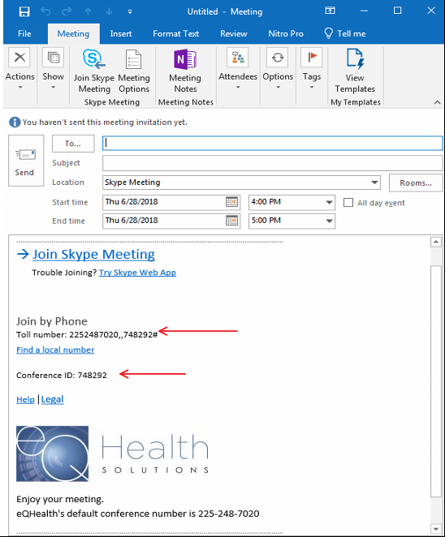
Skype Invitation
Notes:
Scheduling
Available on Outlook toolbar.
Outlook contacts available.
A standard or stagnate meeting request can be saved.
“Join Skype Meeting” takes attendee directly to meeting
I do not use the Skype audio because if you are using a laptop, the audio uses that microphone and as Heather pointed out, that’s not the best option

Slide 22
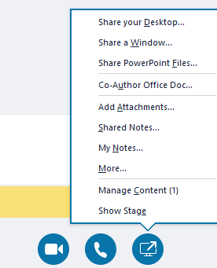
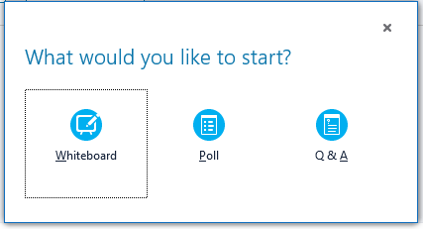
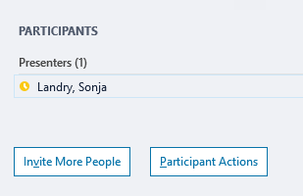
Basics
You can click on “Participants” to see a list of attendees or to “Invite More People”.
Clicking on the “Share Content” button allows you to Share your Desktop as well as “Show Stage” to see what the attendees will view.
“More” provides additional options like Polling.

Slide 23
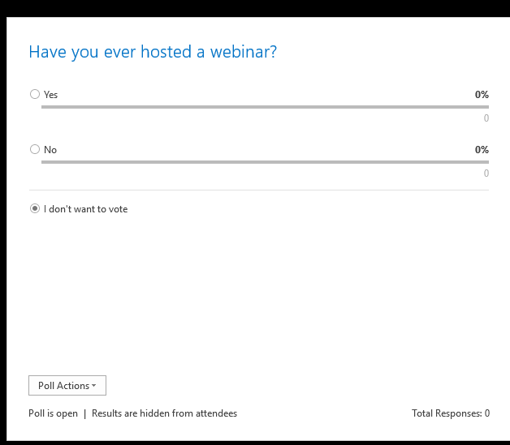
Polling
Notes:
Scheduling
Available on Outlook toolbar.
Outlook contacts available.
A standard or stagnate meeting request can be saved.
“Join Skype Meeting” takes attendee directly to meeting

Slide 24
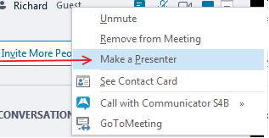
Options
If you initiate a meeting and you need to make someone else the presenter, you right click their name and specify them as the presenter.
When they are done presenting or you would like to present you must right click that user again and make that user an Attendee in the same location as above.
You can share files from the menu in the chat section or other items from the menu shown below (if you hover over each it will tell you what its function is).

Slide 25
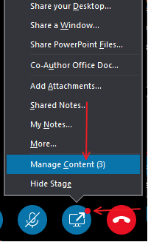
Other Options
Once you have shared content with the meeting participants there will be a red dot showing for them. They must click on this red dot and go to manage content seen below.

Slide 26
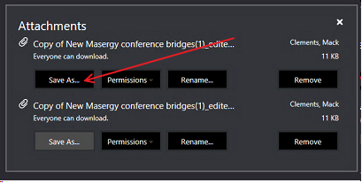
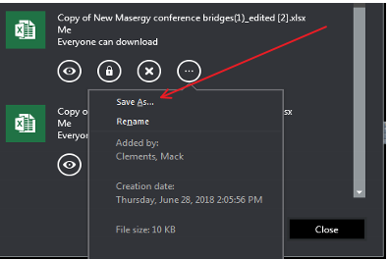
Sharing Data
Once you are in manage content you can download the shared file. From the web version it is the first image and from the client version it is the second image.
Notes:
Those are the basics. Like any software, you need to play with it. Practice, practice, practice! During your practice sessions, I suggest you have someone from outside your company network join to see if there are in issues you might not be aware of like a screen shot is too small or too busy. I also recommend that you reboot your machine prior to hosting an event and only open the documents you will need for the webinar. This will help your computer perform better.

Slide 27
ReadyTalk
Content Provided by the Senior Medicare Patrol (SMP) for California

Slide 28
History
2010 – SMP Expansion Grant
Referral from California Association of Non-Profits
Reviewed other products; ease of use a priority
Plans based on line capacity, budget
Current plan – 150 lines max and $.04/minute phone charge

Slide 29
Current Use
Training for Remote Audiences
Monthly educational webinars w/guest speakers
Invitees: Partners and volunteers
An overview of Medicare fraud
Topics include:
All aspects of Medicare
Medi-Cal Fraud
Consumer Protection
LGBTIQ Cultural Competency
Hispanic Outreach
Medicare for Low-Income Beneficiaries

Slide 30
Pre-Webinar
Identify appropriate topics
Locate subject matter experts
Schedule based on speaker availability
Obtain descriptions, bios, slides
Send announcements multiple times
Post on website
Schedule in ReadyTalk
Registration invitations, registration link
Email speaker slides to registrants

Slide 31
Pre-Webinar (continued)
Conduct dry run with guest speaker and SMP
Introductions
Test compatibility with speaker’s technology
Can we record the session?
Who will move slides?
When to take questions?
Chat or ?

Slide 32
Day of Webinar
All speakers log on 15 minutes prior to start
Promote speakers
Activate audio (attendees can call in or use PC)
Do sound check, mute all lines
Welcome, hosted by, set recording
Check for attendee questions, comments

Slide 33
Post-Webinar
Survey pop-up before logout
Solicit feedback, webinar ideas
Send speaker thank you
Send survey questions to appropriate speakers
Send survey feedback to guest speaker

Slide 34
CHALLENGES
Sound of speaker’s voice during webinar
No closed captioning
No animation available
Video sound low
Slides must be in PPT (not PDF)
Managing listeners who always ask for slides
Managing listeners who can’t hear speaker
Working with busy speakers to get bio, description, slides
Ensure we have a webinar backup

Slide 35
POSITIVES
Simplicity, Ease of use
Accessibility of reports
Registration for training credits in SIRS
Attendance, chat logs
Recording stored for any length of time (monthly fee)
Video option available (view the speaker)
Customer support always available for attendees, moderator
Price remains stable (under $1000/year)

Slide 36
ReadyTalk and ZOOM
Content Provided by the National Council on Aging (NCOA)

Slide 37
ReadyTalk: Pros
Easy to use interface
Can invite/email directly from the platform
Tailorable registration fields and post-event surveys
On-demand meetings (no scheduling required)—great for last minute need to share screens/documents with your colleagues
Audio via web and/or phone
Can flag questions & answers to make them easier to find
Easy to download attendee information, chat questions
Can edit recordings in the platform
Can password-protect recordings and get notice of who’s viewed
Useful for recording training webinars

Slide 38
ReadyTalk’s easy-to-use interface (presenter view)

Slide 39
ReadyTalk: Cons
Price
Basic webinar package is $99 for up to 100 participants/month
Any more than 100-150 participants and you must upgrade to pricier operator-assisted webinar
Cannot post files to download
No built-in closed captioning
Videos don’t play well within the platform
Character counts on polling questions
Cannot significantly modify graphics/logos in emails sent from platform
Can edit recordings in the platform
Periodic technical issues (lines cutting out, delay in moving slides)

Slide 40
Zoom
Video conferencing tool that can be used for meetings, webinars and webcasts
Cost efficient
Cloud-based and encrypted
Automatically generates a transcript after recorded events
Can also buy closed captioning (third party integrated tool)
Broadcast live on YouTube and Facebook
PayPal integration to monetize webinars
Cannot edit recording in the tool
No email direct from system—integrates with other tools

Slide 41
Zoom Bonus Tips
If you use the feature to send emails from any platform (invitations, surveys, etc.), ask your team members to add the sending account to their safe senders list.
When using chat/Q&A features, pick one, but don’t use both.
People tend to get confused and just send their question in both, which means twice as much work for the host.
To more easily manage lots of chat questions, copy them from the web conferencing chat box into a Word document.

Slide 42
FAQ: What web conferencing options can I get for free (or almost free)?
Zoom: 40-minute sessions for free or unlimited use for $15/month
Google Hangouts: A Chrome extension that provides free video conferencing
Skype for Business: Free for a limited number of accounts

Slide 43
FAQ: Where can I find free (or low cost) pictures?
www.freeimages.com has a limited selection of free images to download
www.stocksky.com has photos starting from $15-30
www.blendimages.com features more racial/ethnic diversity; photos start at $20
https://unsplash.com/ has free photos with diverse audiences
https://pixabay.com/ also has free photos
Take your own photos! Get photo releases.

Slide 44
FAQ: Which platforms offer closed captioning?
Platform | Panelists say…
WebEx | Available in Meeting Center but not Event Center
Go To Meeting/Go To Webinar | No closed captioning
ReadyTalk | No built-in closed captioning
Zoom | Automatically generates a transcript after recorded events; can also buy closed captioning (third party integrated tool)
Skype for Business | Language can be selected along with closed captions
Disclaimer: This information is intended to provide an informal and impartial comparison, based on what panelists learned when doing their own research. It may no longer be current! Please ask each provider for yourself as you do your own research.
Tip: Third-party tools are also available for closed captioning. VITAC is one common source: (https://www.vitac.com/live-closed-captioning/)

